Slide 1



CYBER SECURITY
TASK 3
CYBER SECURITY
ZUHRA SHAVKATOVA
PAGE
01/15

Slide 2

I SCANNED THE NETWORK 194.30.27.0/24 AND
I FOUND 16 HOSTS WITH SEVERAL OPEN PORTS BETWEEN 20 AND 1000 PORTS.
PAGE
04/15

Slide 3
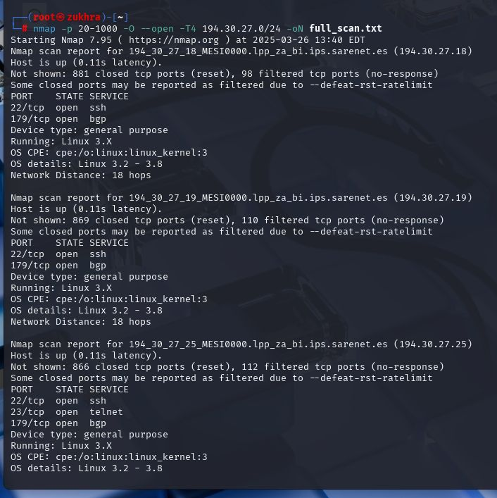

SCANNING
nmap -p 20-1000 -O --open -T4 194.30.27.0/24 -oN full_scan.txt
-Scans all ports (20-1000)
-O → Detects the Operating System (OS) of hosts.
--open → Shows only open ports.
-oN full_scan.txt → Saves results in full_scan.txt.
-T4 increases speed. It helps to scan faster.
PAGE
02/15

Slide 4

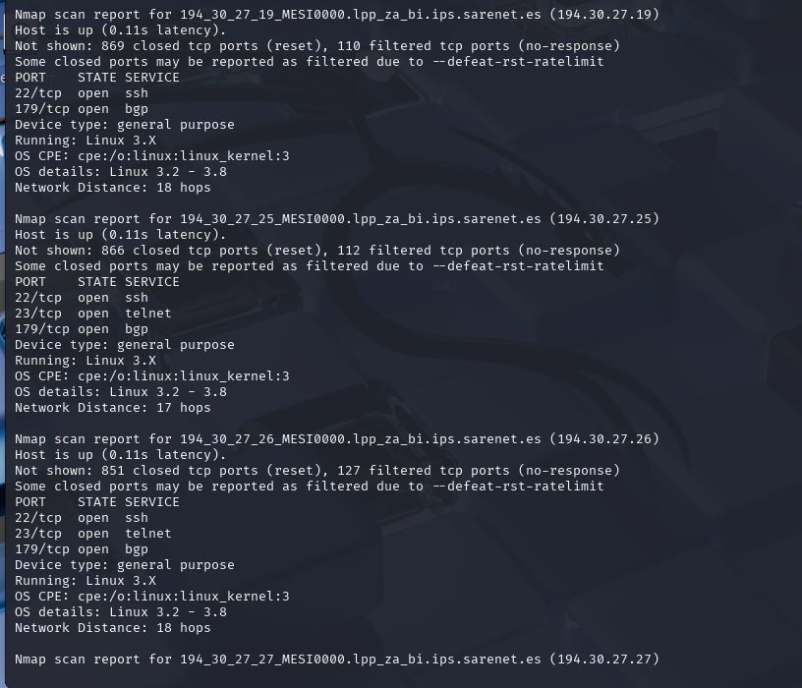
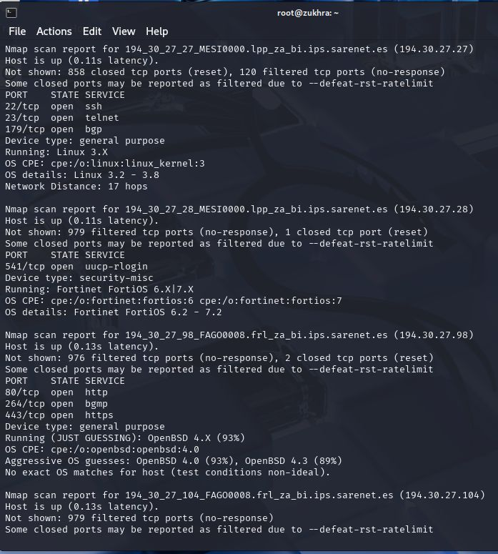


PAGE
03/15

Slide 5
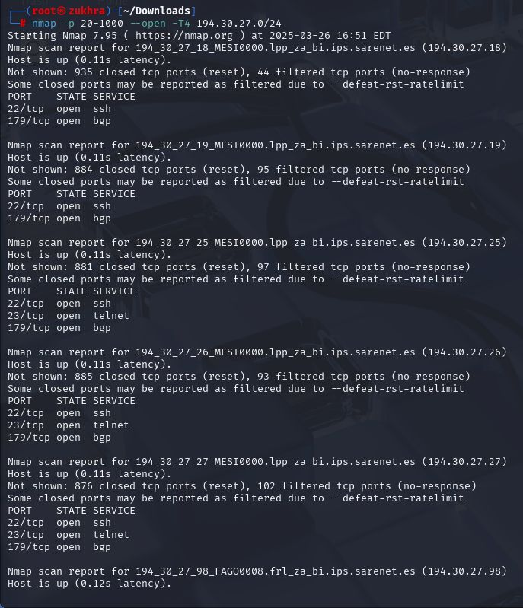
OPEN PORTS ARE 22/SSH
179/BGP
23/TELNET
443/HTTPS
80/HTTP
264/BGMP
PAGE
05/15

Slide 6
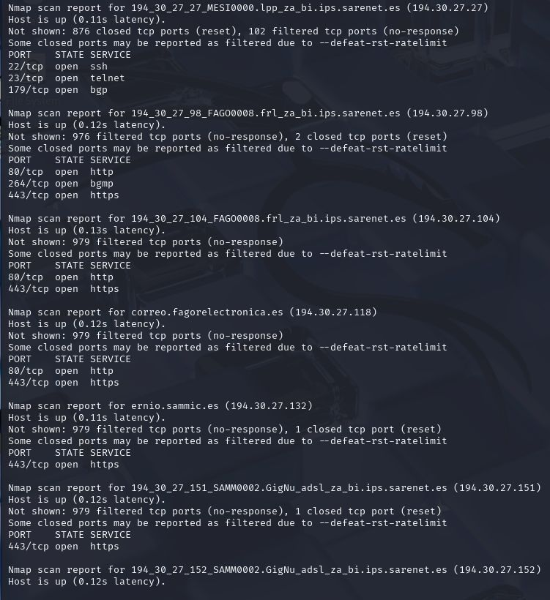
OPEN PORTS ARE 22/SSH
179/BGP
23/TELNET
443/HTTPS
80/HTTP
264/BGMP
PAGE
05/15

Slide 7
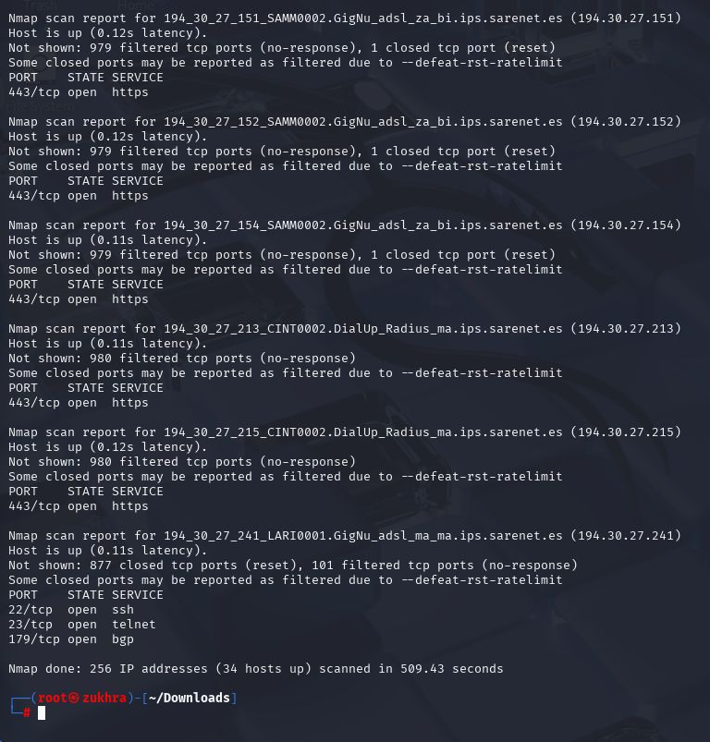
OPEN PORTS ARE 22/SSH
179/BGP
23/TELNET
443/HTTPS
80/HTTP
264/BGMP
PAGE
05/15

Slide 8
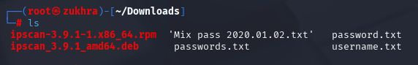

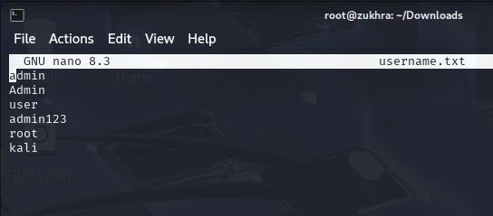
PASSWORDS
USERNAMES
I created the username.txt file using sudo nano and added common usernames to it.
6AGE
07/15

Slide 9
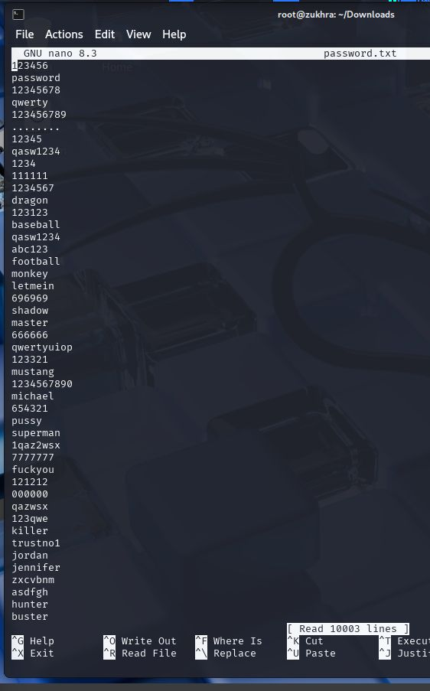
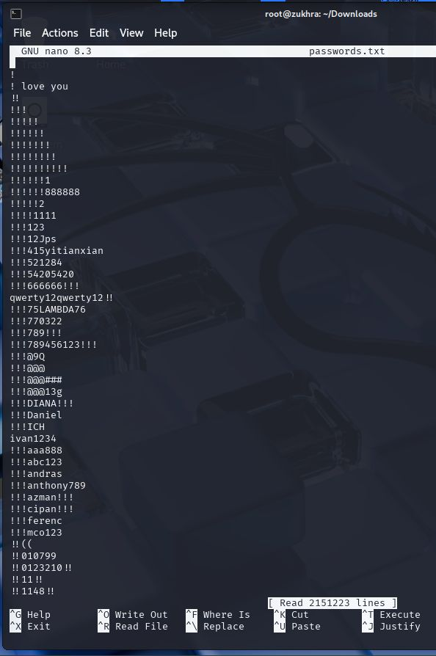
PASSWORDS
USERNAMES
However, I do not created password.txt file. But I found it online. This file contains commonly used passwords,
10003 passwords have in this file.
2151223 passwords have in this file.
6AGE
07/15

Slide 10

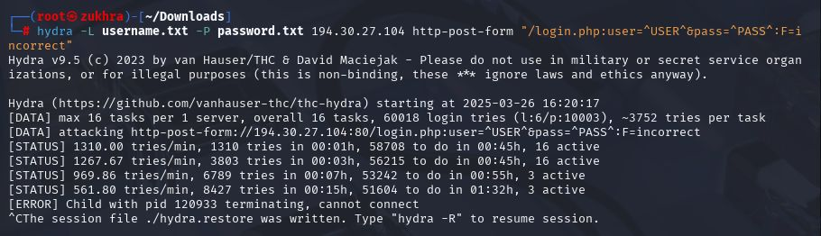
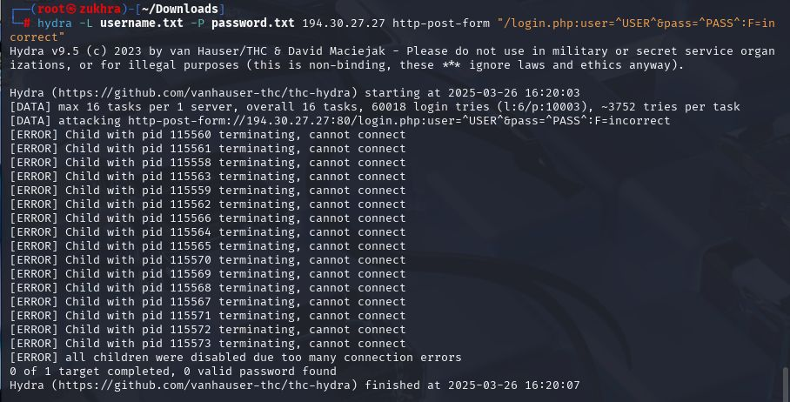
ATTACKING
This command is brute-force attack on a web login form by using Hydra.
-L username.txt → Uses a list of usernames from username.txt.
-P password.txt → Uses a list of passwords from password.txt.
I tried to guess the passwords,
6AGE
06/15

Slide 11
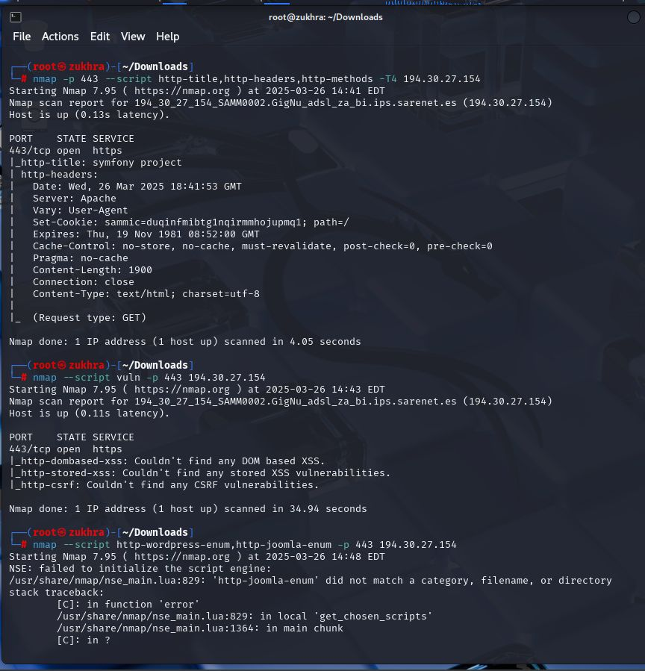
ATTACKING
I Scanned port 443 to gather information and check for vulnerabilities.
I did not find any critical vulnerabilities related to XSS or CSRF.
6AGE
06/15

Slide 12
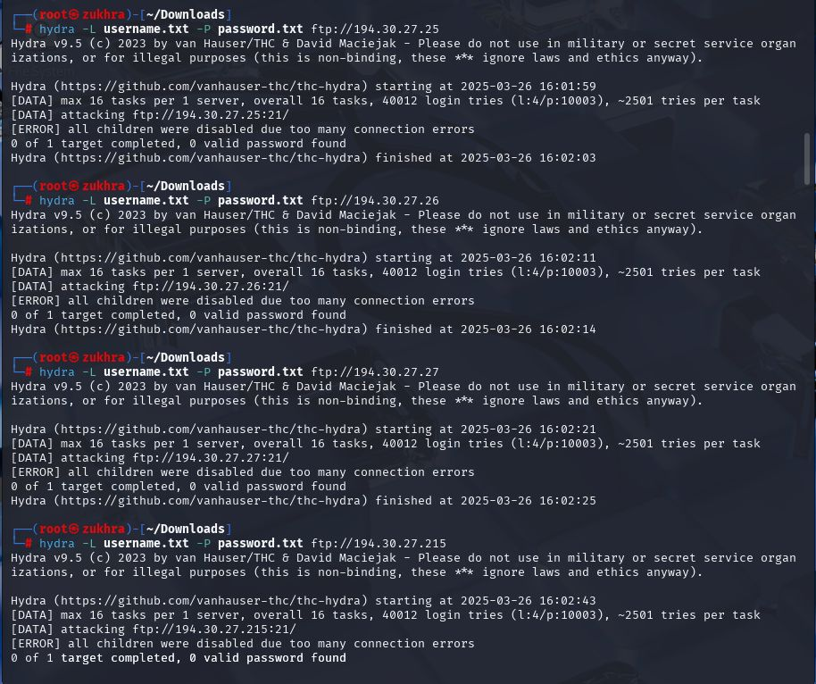
ATTACKING
This command is brute-force attack on FTP server by using Hydra.
-L username.txt → Uses a list of usernames from username.txt.
-P password.txt → Uses a list of passwords from password.txt.
6AGE
06/15

Slide 13
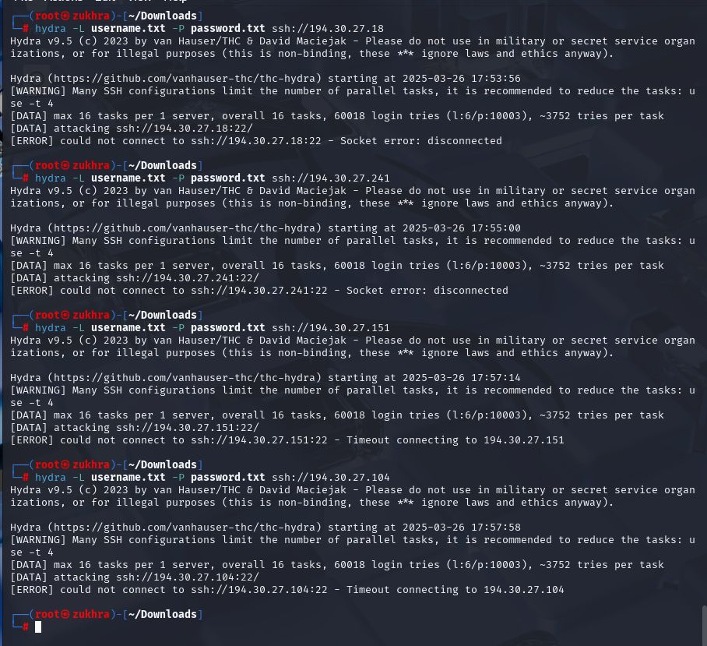
ATTACKING
This command is brute-force attack on SSH/22 server by using Hydra.
-L username.txt → Uses a list of usernames from username.txt.
-P password.txt → Uses a list of passwords from password.txt.
6AGE
06/15

Slide 14
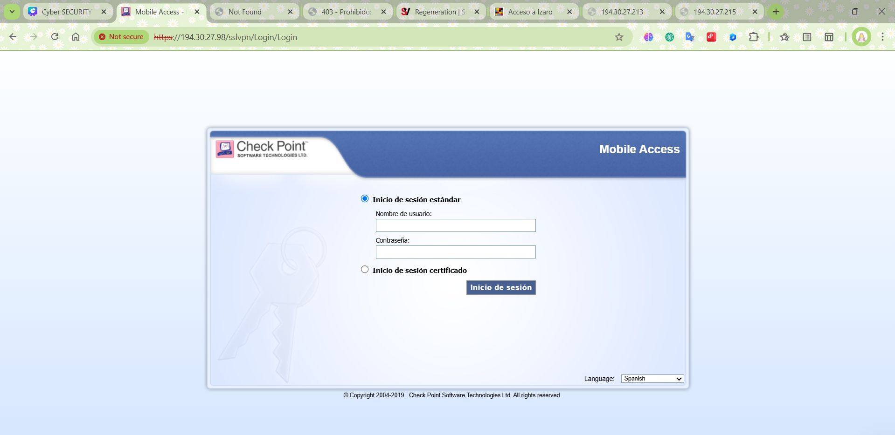
ATTACKING BY USING HTTP/HTTPS

Slide 15
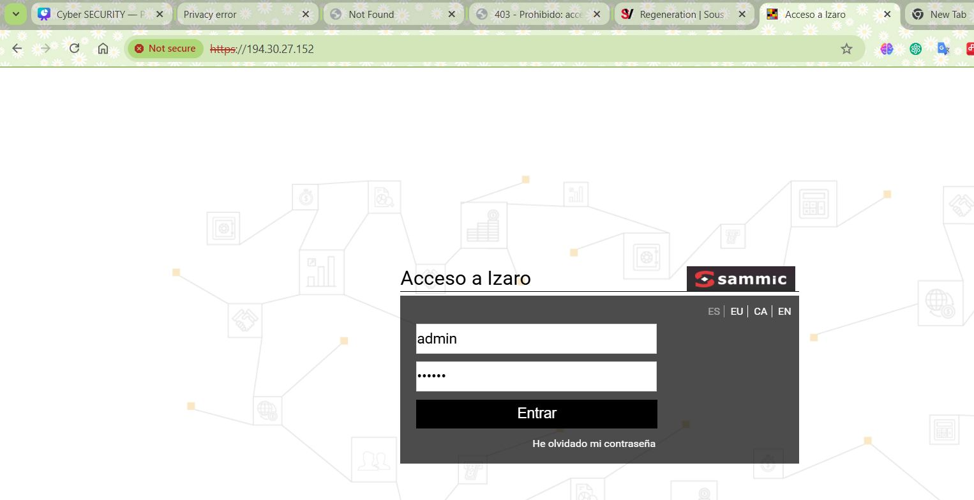

Slide 16


Slide 17
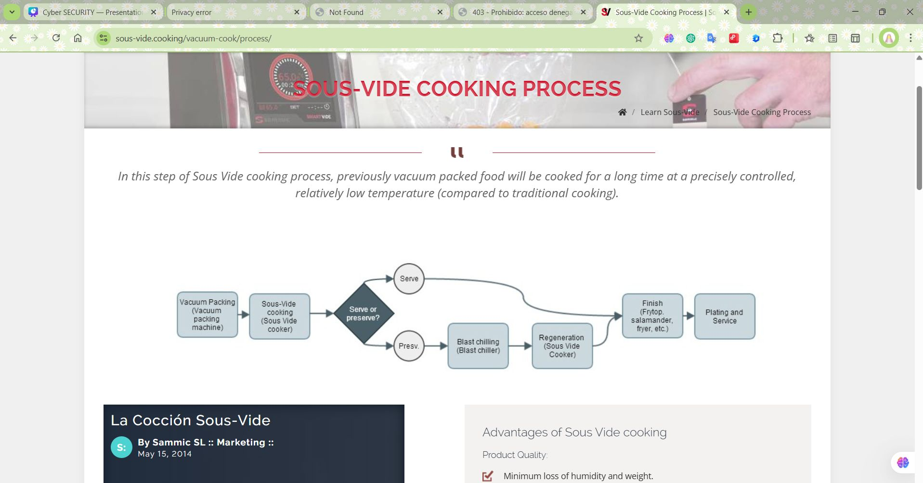

Slide 18

THANK YOU!
PAGE
15/15

